Slide 1
Agenda
Artificial Intelligence
From ANI to AGI to ASI
An example of deep learning in Computer Vision
Recent Advance in AI Technologies
Generative Models
Reinforcement Learning
Ensemble-based Learning
Transfer Learning
Pitfalls and Risks in AI
Adversarial Examples

Slide 2
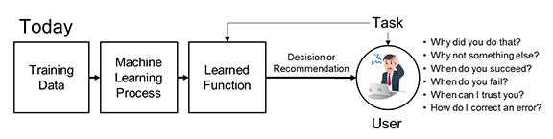
Pitfalls and Risk of AI
Pitfalls and Risk of AI
AI systems can be fooled
Deep learning algorithms are far away from “explainable”
Poor quality of data
Good information to make good decisions
Uncertainty
Solutions
Explainable deep learning
Uncertainty quantification

Slide 3

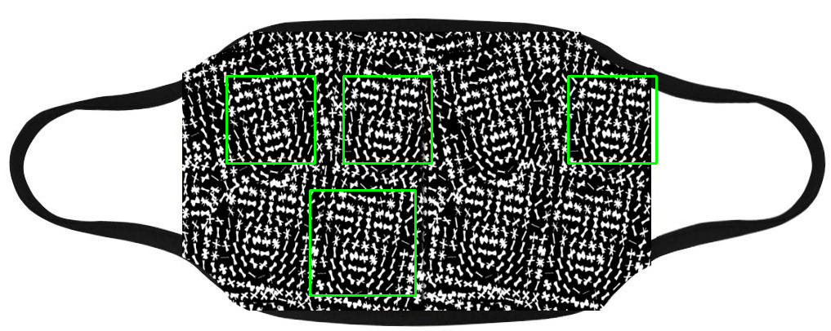
Fooling the Facial Recognition Systems
A face recognition system can be fooled by 3D printed face mask, a picture, or even a mask with patterns.

Slide 4
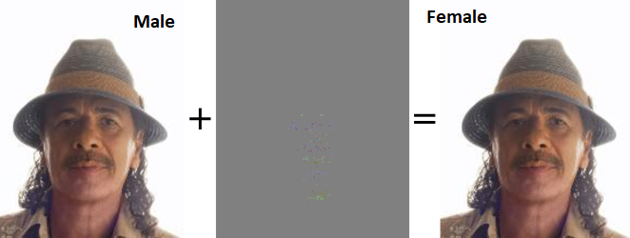
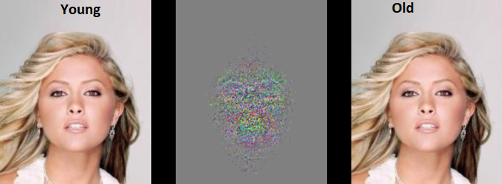
Adversarial Examples by Attribute Flipping
Adversarial examples generated by fast flipping attribute (FFA) technique by adding small, non-random perturbations to original inputs.
The modifications remain imperceptible to human observers.
Machine learning models are vulnerable to classify the original and adversarial example.
Are Facial Attributes Adversarially Robust? arXiv:1605.05411
Andras Rozsa, Manuel Günther, Ethan M. Rudd, Terrance E. Boult

Slide 5
Synthetic Media
Nicolas Cage as Lois Lane
Mr. Bean as Lois Lane and Superman
DeepFake: Replace a person in an existing image or video with someone else's likeness
Image Source: DeepFake

Slide 6
Data Quality
Machine Learning has a single point of failure – Bad Data
Common data quality problems
Data sparsity
Data corruption
Irrelevant data
Bad labeling
Unbalanced data
Missing data
Learning wrong patterns
…

Slide 7

Flower Classification Project

Slide 8
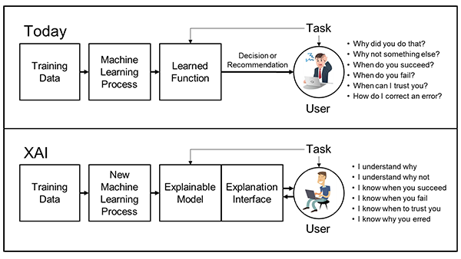
Explainable AI (XAI)
Explainable models, while maintaining a high level of learning performance (prediction accuracy)
Enable human users to understand, appropriately trust, and effectively manage the emerging generation of artificially intelligent partners.
Image Source: DARPA

Slide 9
Schedule of the Seminar Series
June 4: Survey of Artificial Intelligence
June 11: Survey of Big Data Analysis
June 18: Dimensionality Reduction
June 25: Generative Adversarial Networks
July 2: Semi-supervised Learning
July 9: Feature Generation, Extraction, and Selection
July 16: Object Detection
July 23: Sensor Data Processing and Learning
July 30: Ensemble-based Learning
August 6: Pitfalls and Risks of AI and Big Data Analysis

Slide 10
Summary
Artificial Intelligence
ANI
Toward AGI and ASI
Recent Advance in AI Technologies
Generative Models
Reinforcement Learning
Ensemble-based Learning
Transfer Learning
Pitfalls and Risks in AI
Explainable Deep Learning is the Key

